Slide 1
GRAMENER CASE STUDY SUBMISSION
Group Name:
Rakesh Kanugula
Sharath Athrey
Sumit Kaushik

Slide 2
Problem Statement
Consumer Finance Company, a specialized bank in lending different types of loans to Urban customers.
The company needs to evaluate several risks before it can take decision on the below cases :
1. If the applicant is likely to repay the loan, then not approving the loan results in a loss of business to the company
2. If the applicant is not likely to repay the loan, i.e. he/she is likely to default, then approving the loan may lead to a financial loss for the company
3. The aim is to identify patterns which indicate if a person is likely to default, which may be used for taking actions such as denying the loan, reducing the amount of loan, lending (to risky applicants) at a higher interest rate

Slide 3

Problem / Data Analysis
Data Understanding :
- Data provided contains complete loan data for all loans issued through the time period 2007 t0 2011 (4 years)
- Data Categories – “Current” – “Fully Paid” – “Defaulted”
- Data has other customer information like (some of the important ones being)
- Purpose of the Loan
- Bankrupcy
- Annual Income of the borrower
- Loan Term
- Verification
- Issue and Last Payment date
- Application Type
- Home Ownership
- Loan Status
- Last Credit Pull date
- Data also has several columns that has NA values that can be safely ignored for analysis

Slide 4
Problem / Data Analysis
Overall Workflow Stages:
- Load complete Data for performing analysis
- Perform Data Formatting / Data Cleaning
- Identify and filter Data Outliners based on selected columns
- Data filtering based on Loan Status (“Current” / “Default” / “Fully Paid”)
- Perform Univariate Analysis on cleansed / formatted Data Set
- Perform Bivariate Analysis on cleansed / formatted Data Set
Assumptions made during Data Analysis :
- Only “Default” and “Fully Paid” loan types or loan status are considered for analysis
Tools Used :
- Rstudio is used for complete data analysis including Data formatting, cleaning, slicing, dicing and plotting.

Slide 5
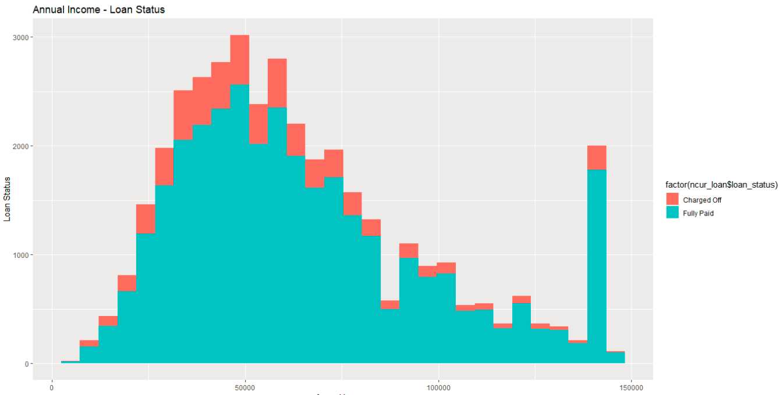
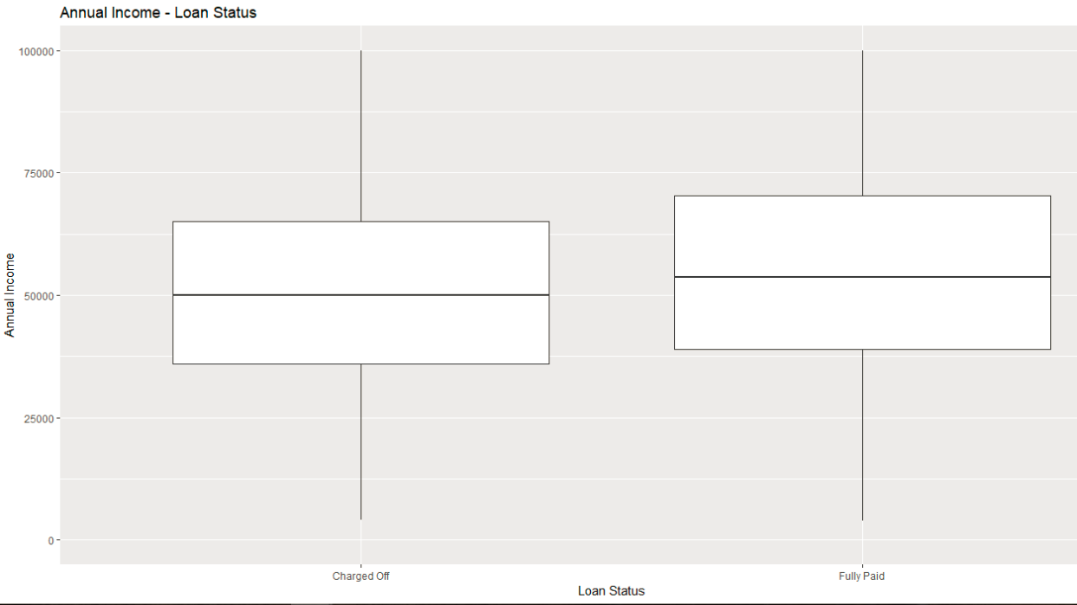
Annual Income vs Loan Status Plots
Plot 3: Annual Income vs Loan Status - Histogram
Plot 4: Annual Income vs Loan Status – Box Plot

Slide 6
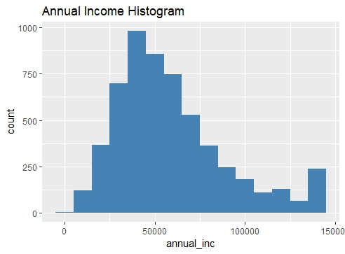
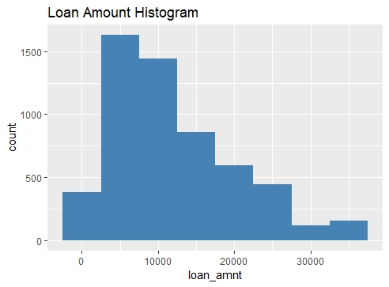
Annual Income and Loan Amount Analysis
The Annual income analysis on charged off loans clearly shows that people having annual income less than 75000 are more likely to default.
The loan amount analysis on charged off loans clearly shows that people having loan amount less than around 22000 are more likely to default.

Slide 7
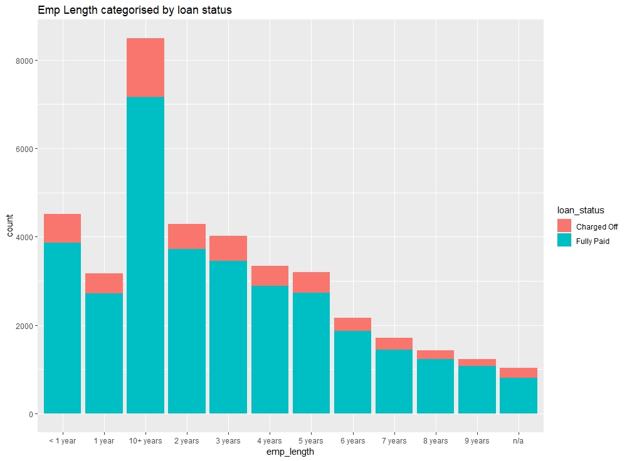
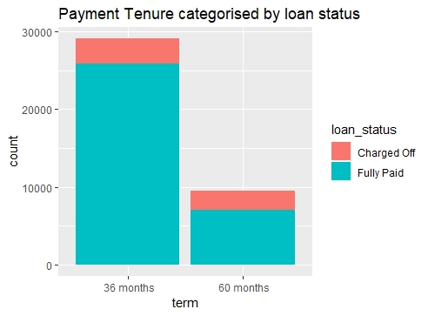
Term and Employment Length Analysis
Term | Loan Status | Percentage
36 months | Charged Off | 11.09087
60 months | Charged Off | 22.59674
60 months | Current | 10.73345
36 months | Fully Paid | 88.90913
60 months | Fully Paid | 66.66981
The analysis on employment length does not give any specific insight.
The payment term analysis clearly shows that people having loan term 60 months are more likely to default.

Slide 8
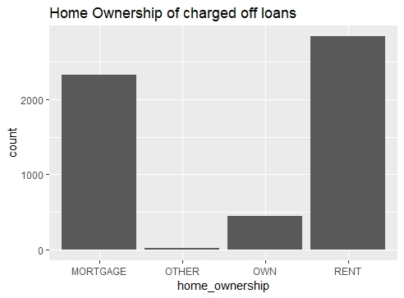
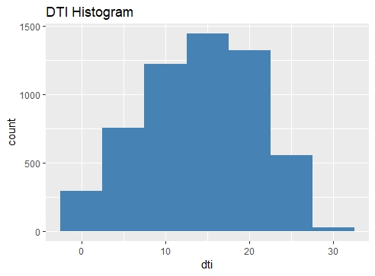
Ownership and DTI Analysis
The home ownership analysis on charged off loans clearly shows that people having rented or mortgage ownership are more likely to default.
The dti analysis on charged off loans clearly shows that people having dti less than around 22 are more likely to default.

Slide 9
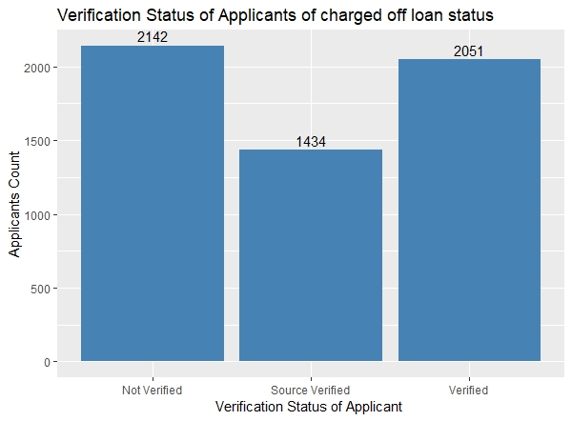
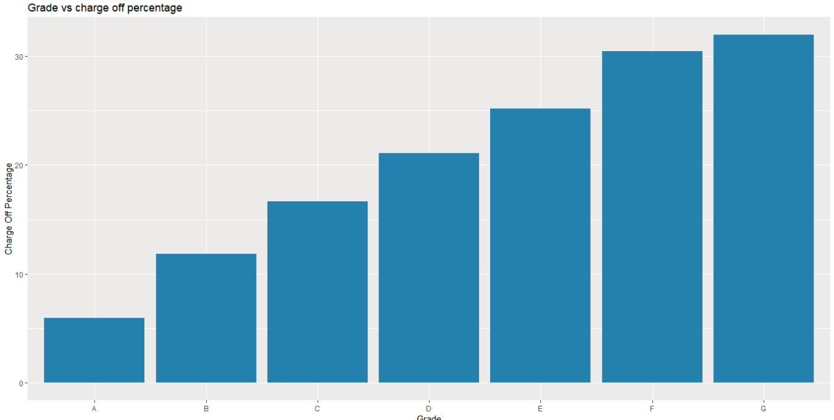
Plot 1: Verification Status on charged off
Verification Status and Grade Plots
Plot 2: Grade vs Charge Off Percentage
The verification status analysis on charged off loans clearly shows that people having source verification are less likely to default.
The grade analysis on charged off loans clearly shows that loans from grade A are less likely to default than grade G.

Slide 10
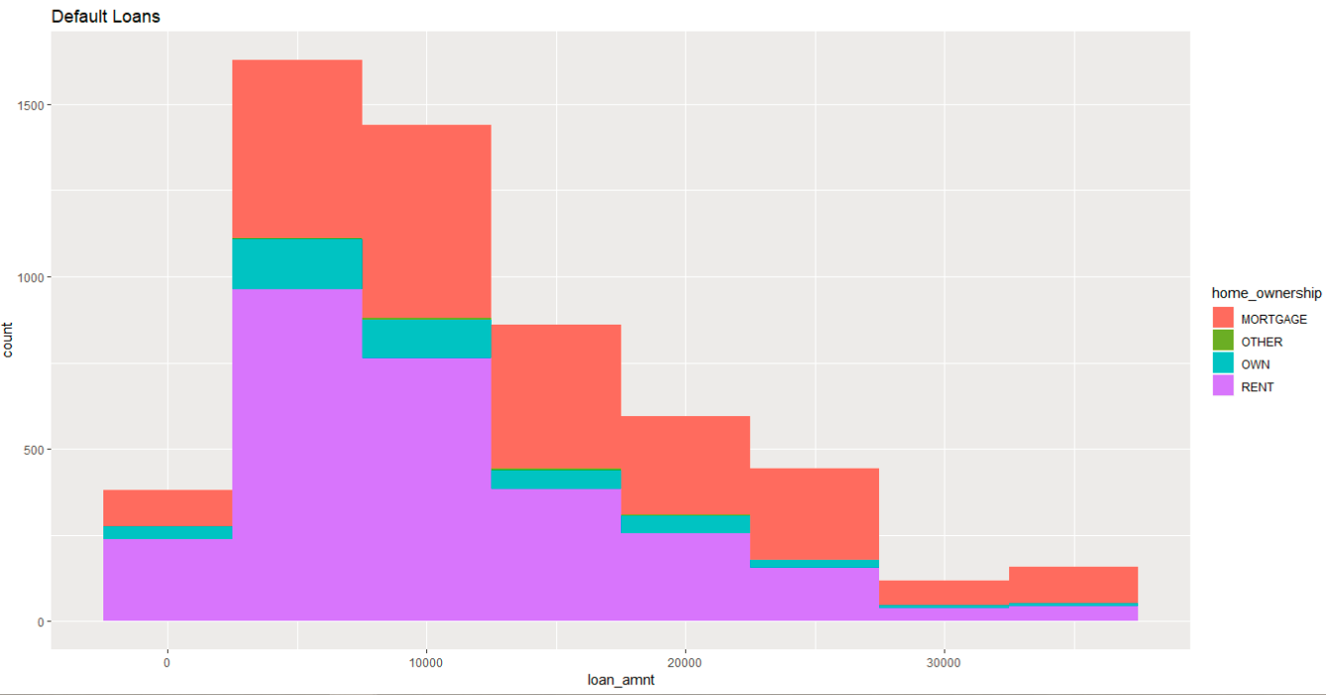
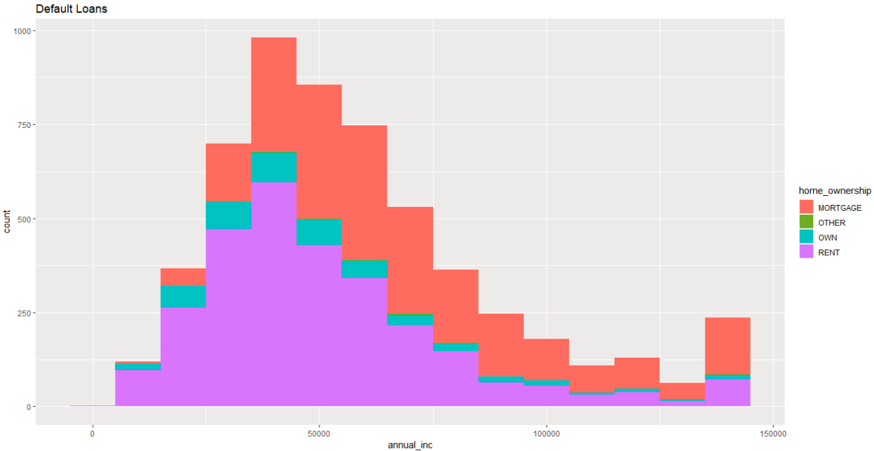
Default Loans Analysis Plots
Plot 5: Defaulters Count vs Loan Amount with Home Ownership categories
Plot 6: Defaulters Count vs Annual Income with Home Ownership categories

Slide 11
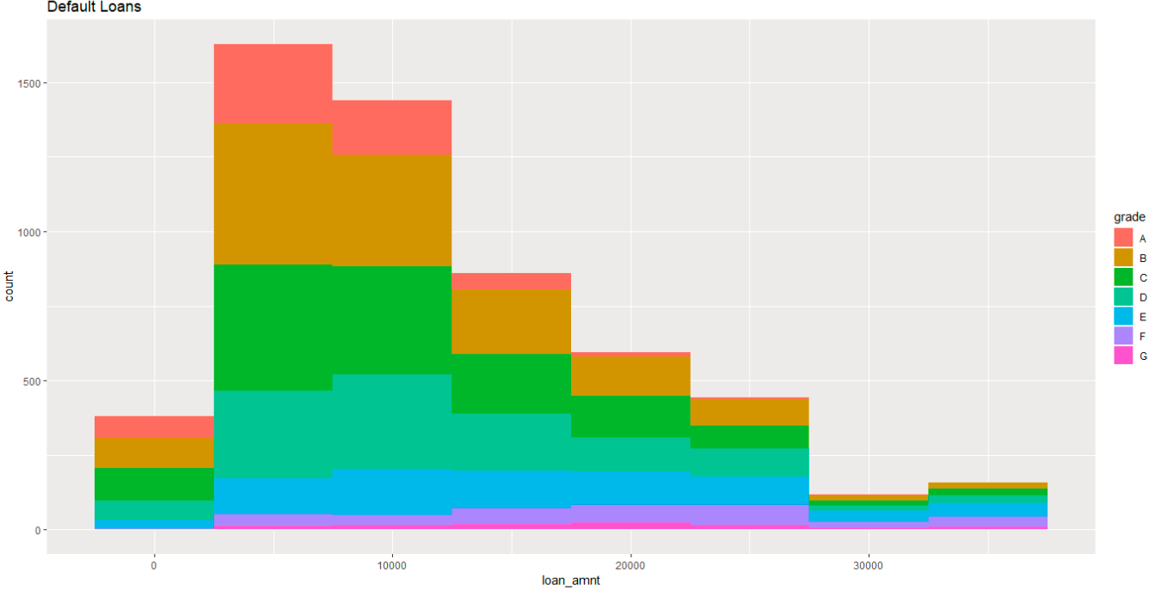
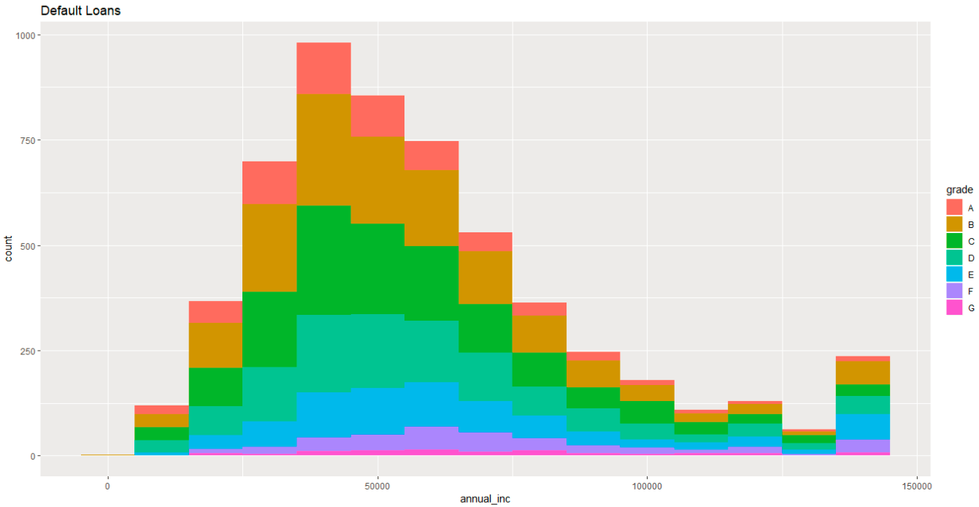
Default Loans Analysis Plots (Cont)
Plot 7: Defaulters Count vs Loan Amount with Grade categories
Plot 8: Defaulters Count vs Annual Income with Grade categories

Slide 12
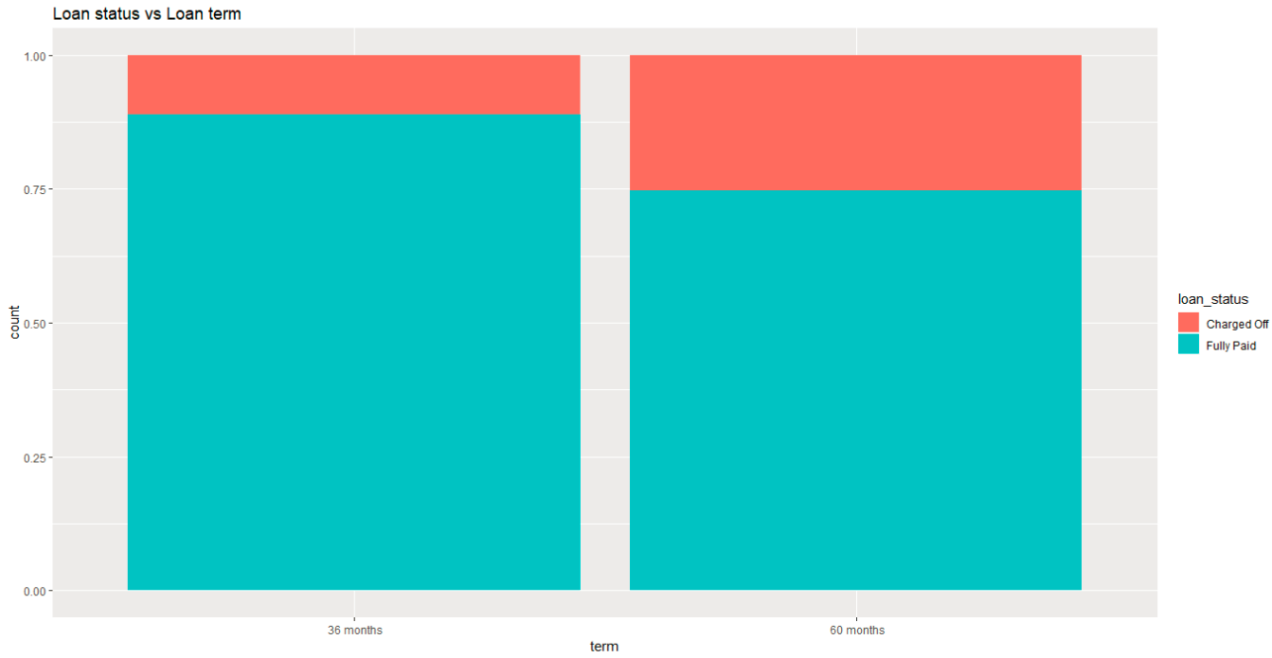
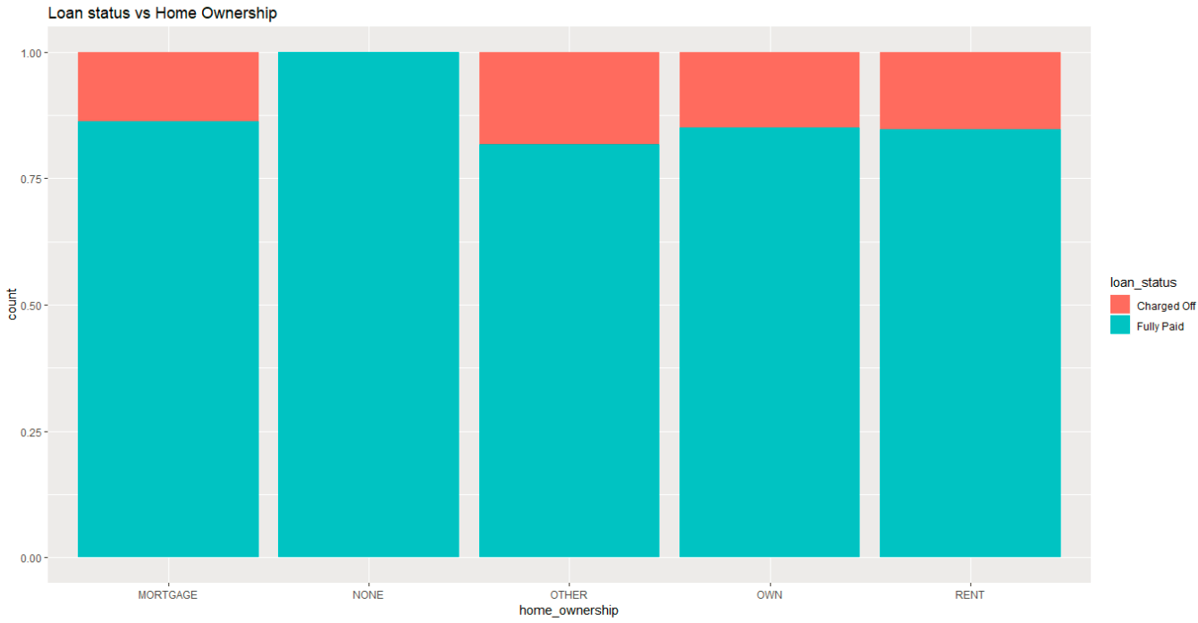
Loan Status Plots
Plot 9: Count vs Loan Term with Loan Status categories
Plot 10: Count vs Home Ownership with Loan Status categories

Slide 13
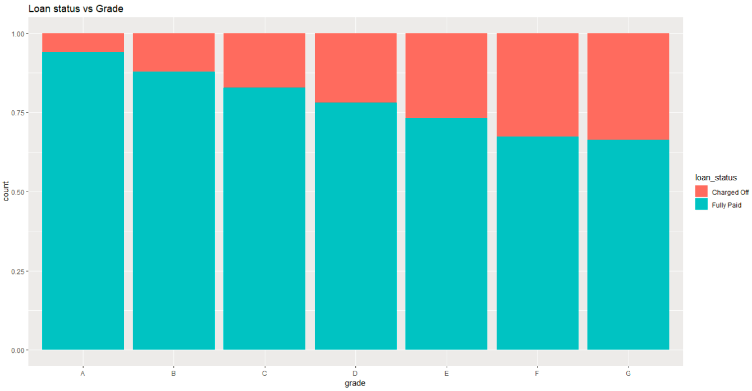
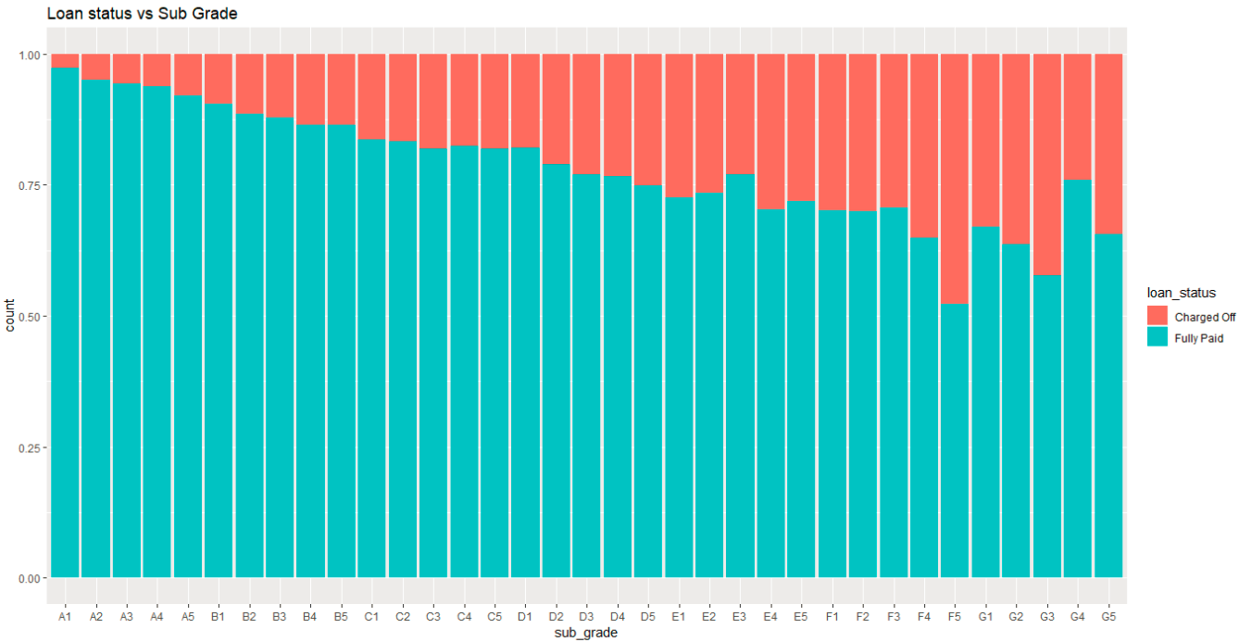
Loan Status Plots (Cont)
Plot 11: Count vs Grade with Loan Status categories
Plot 12: Count vs Sub Grade with Loan Status categories

Slide 14
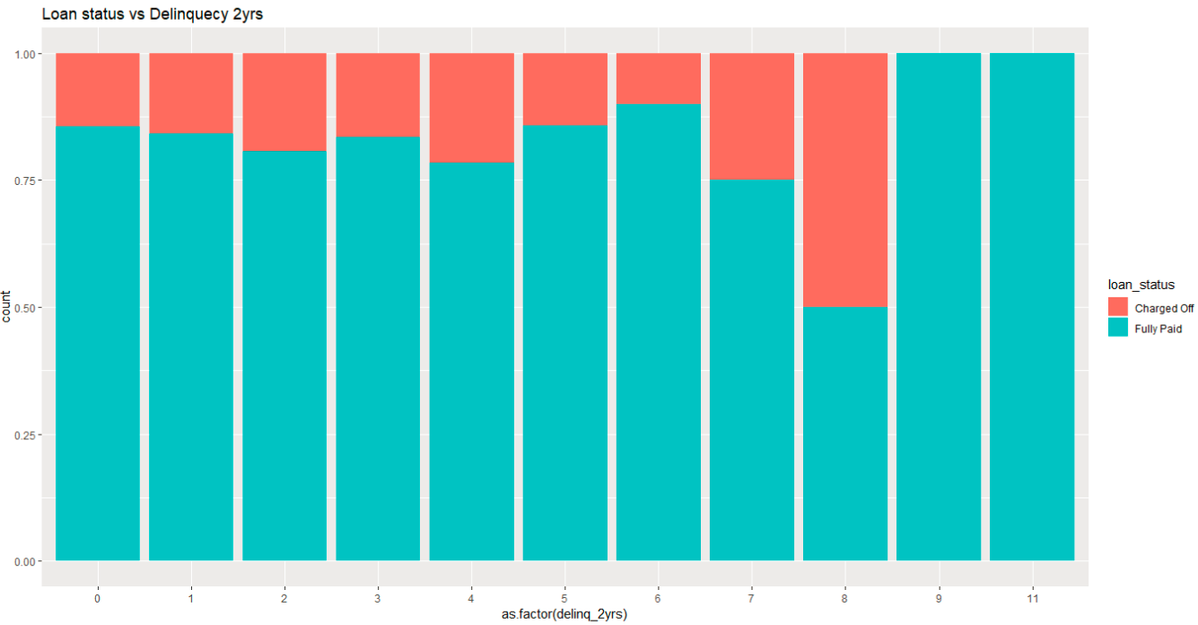
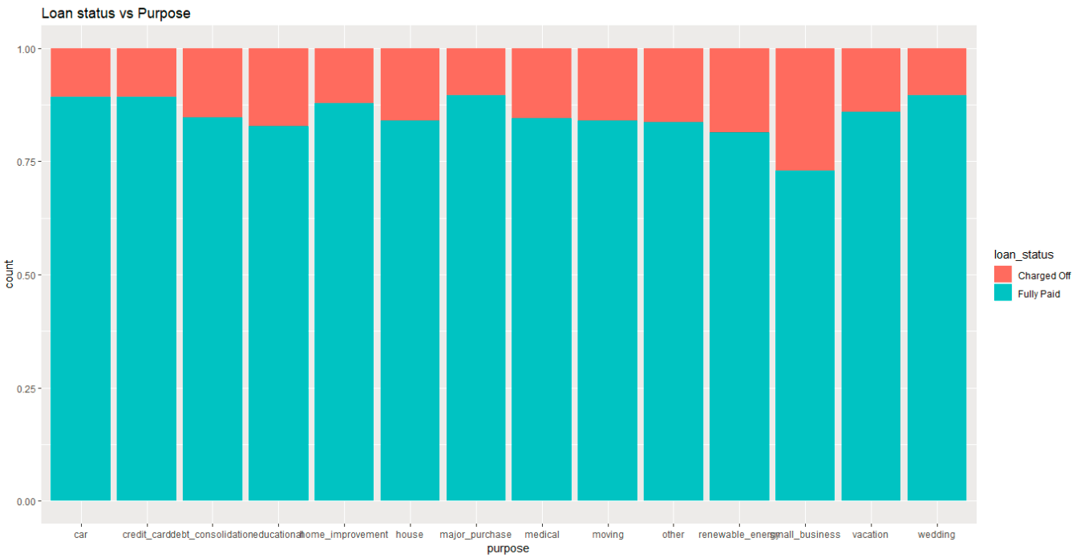
Loan Status Plots (Cont)
Plot 13: Count vs Deliquency (2yrs) with Loan Status categories
Plot 14: Count vs Purpose with Loan Status categories

Slide 15
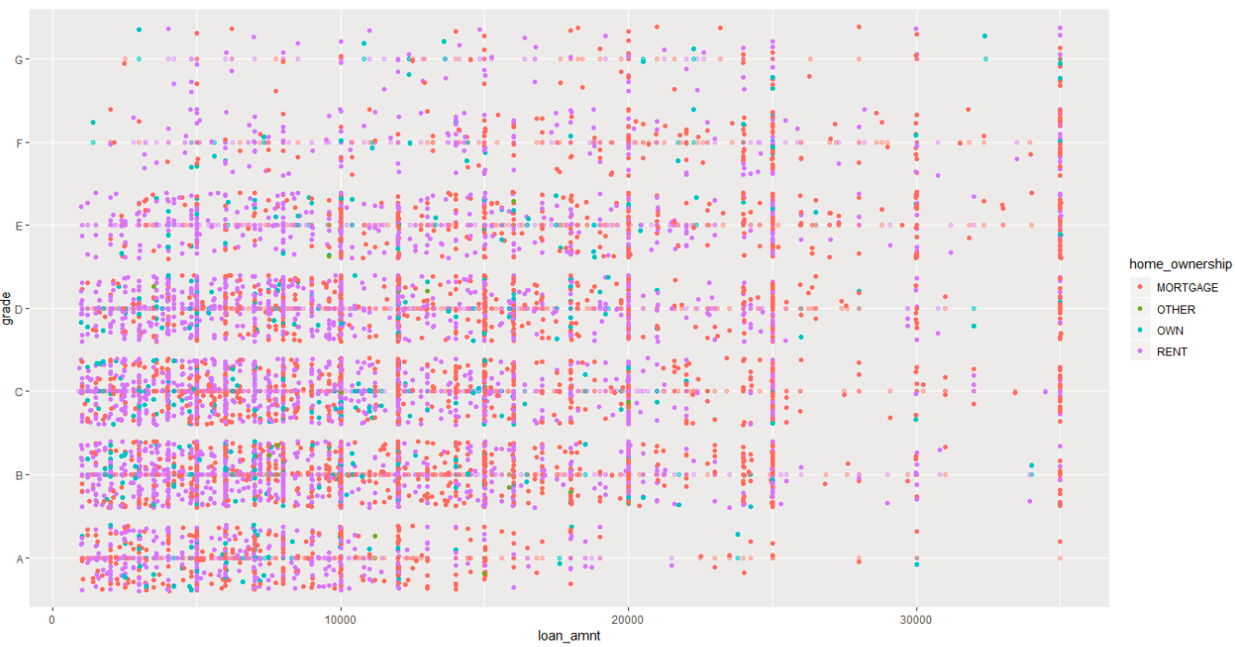
Loan Status Plots (Cont) – Multivariate Analysis
Plot 15: Grade vs Loan Amount with Home Ownership categories on Charged Off Loans

Slide 16
Data Analysis – Conclusion and Proposal
The analysis clearly shows that the following variables have significant impact on loan getting charged off:
Annual Income
Loan Amount
Home Ownership
Term
Grade
DTI
Verification Status
We should be considering the following points while giving loan:
Annual Income should be greater than around 75000.
Loan Amount less than 22000 is more likely to be charged off.
People does not having own home are more likely to default on loans.
Loans having term 60 months are more likely to be charged off .
Loans from grade A, are less likely to be charged off than grade G. The order is A<B<C<D<E<F<G.
The DTI should be more than 22. Higher DTI means loan less likely to be charged off.
Source Verified loans are less likely to be charged off.

